Slide 1
HDAT9700
Interrupted time series analysis
Online tutorial

Slide 2
Overview
What is interrupted time series (ITS) analysis, why do we need it, and when to use it?
Performing ITS analysis using segmented regression and ARIMA

Slide 3

What is interrupted time series analysis?
Interrupted times series analysis uses time series data to answer causal questions
- Ideal for evaluating population-level policies or interventions
- One of the strongest study designs if an RCT is not feasible

Slide 4
Why is interrupted time series analysis needed?
Population-level policies and regulations cannot easily be evaluated by randomised trials and are often implemented with a limited evidence base supporting their efficacy.
But…
Once implemented, did these interventions have the intended impact on health outcomes?
Did they have any unintended consequences?
How can we find out, given that everyone is exposed to the intervention?

Slide 5
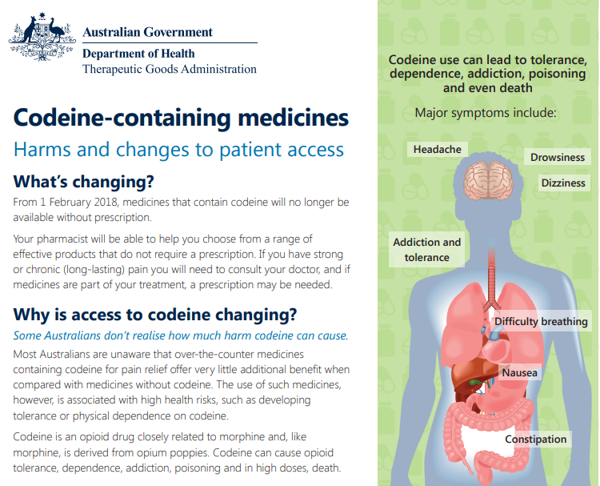
Example – codeine rescheduling in Australia
In February 2018, the Therapeutic Goods Administrative rescheduled codeine-containing products from OTC to prescription-only.
What are the expected, positive outcomes of this intervention?
What are the potential negative outcomes?
Which outcomes can be measured using administrative data?

Slide 6
Example – codeine rescheduling in Australia
Desired positive outcomes
Reduction in codeine dependence
Reduction in inappropriate use of codeine
Reduction in codeine overdose/poisonings
Better pain management
Potential negative outcomes
Increased medical costs (due to GP visits)
Increased demand on healthcare system
Increased use of strong (or other inappropriate) opioids
Poorer pain relief

Slide 7


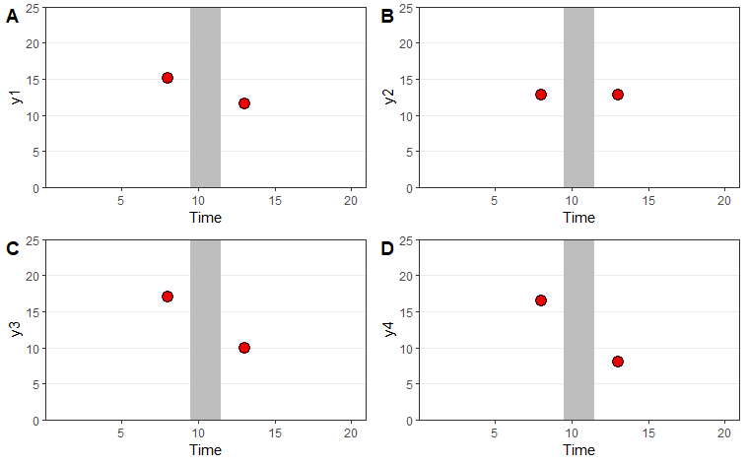
Comparing the red dots before-and-after the intervention (in grey), was there a reduction in the outcome y?
What about a before and after design?

Slide 8
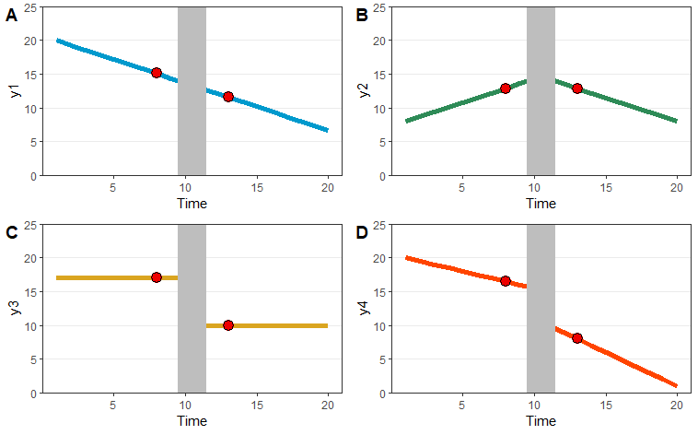
Here’s what it looks like if we plot the outcome over time (i.e. time series). Is your conclusion the same?
What about a before and after design?

Slide 9
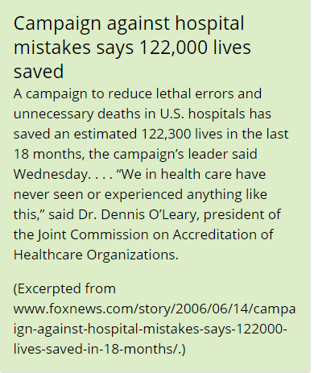
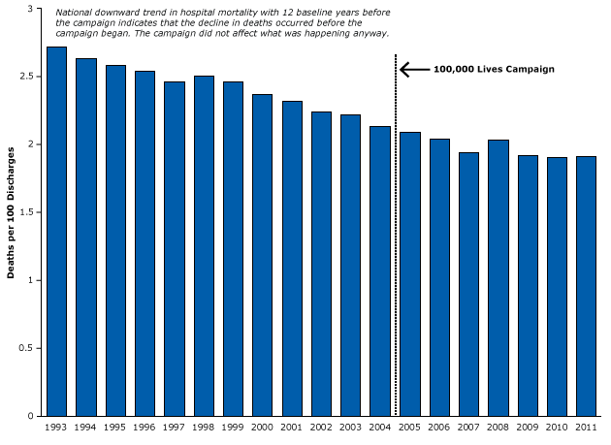
What about a before and after design?
Soumerai et al. Prev Chronic Dis 2015;12:150187. DOI: http://dx.doi.org/10.5888/pcd12.150187
Notes:
This was a study to measure the impact of a large patient safety program on death rates in one hospital network. The program focused on six goals, including reducing the number of adverse drug events, birth traumas, fall injuries, hospital-acquired infections, surgical complications, and pressure ulcers

Slide 10
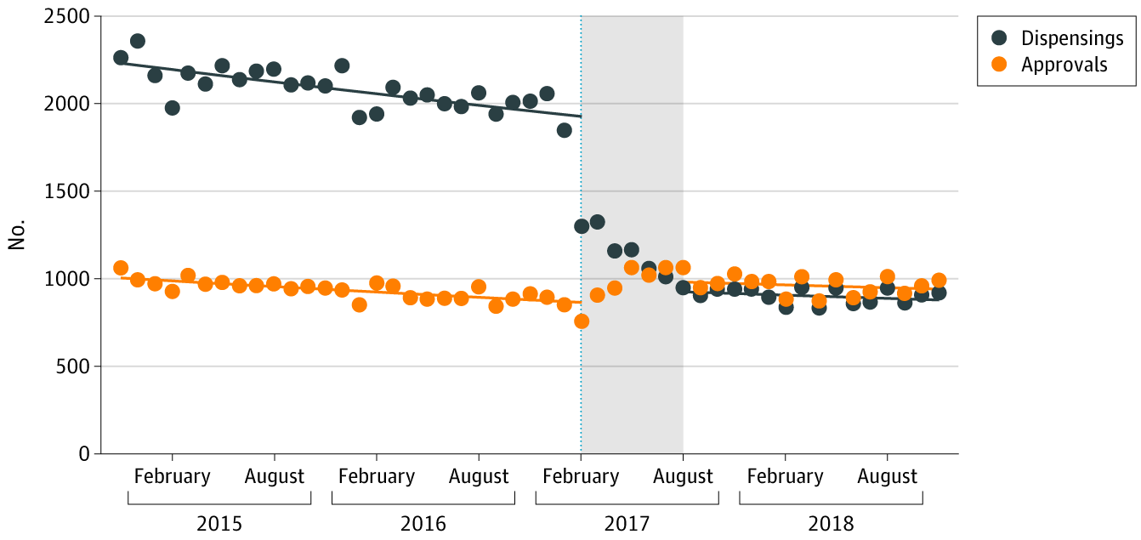
ITS analysis takes advantage of the natural experiment occurring when an intervention is implemented
Intervention: Subsidy changes for alprazolam
Control period
Post-intervention period
Source: Schaffer at al. JAMA Network Open 2019;2(9):e1911590.

Slide 11
What types of interventions can be evaluated?
Occurs at well-defined point in time, with clear “before” and “after” periods
In some cases there may be a “transition” period, e.g. due to gradual roll-out of intervention
Affects a large proportion of population of interest

Slide 12
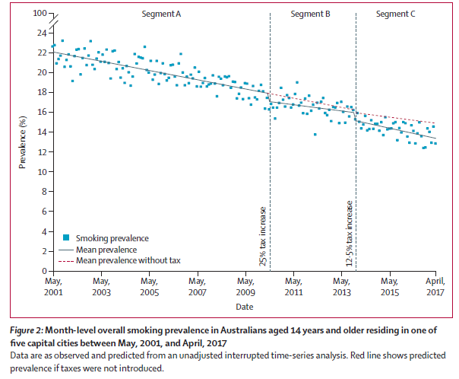
Intervention = Tax increases on tobacco products
Outcome = smoking prevalence in Australian capital cities
Source: Wilkinson et al. Lancet Public Health. 2019;4:e618-27;

Slide 13
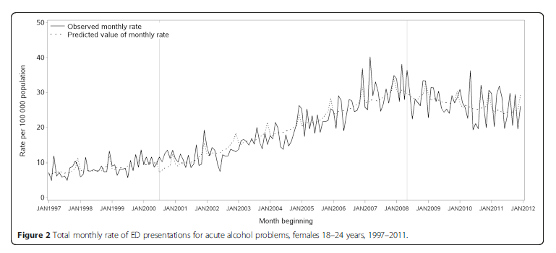
Intervention = Price decrease (2000) and increase (2008) on ready-to-drink alcoholic beverages (“alcopops”)
Outcome = ED presentations for acute alcohol problems in young women
Source: Gale et al. BMC Public Health. 2015;15:468.

Slide 14
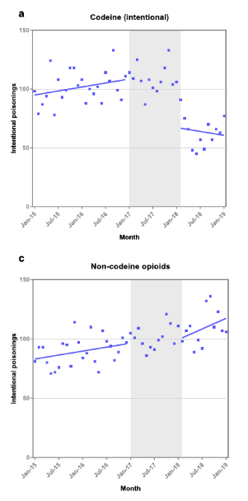
Intervention = Rescheduling of codeine from over-the-counter to prescription-only
Outcome = Poisonings calls to the NSW Poisons Information Centre
Source: Cairns et al. Addiction. 2020;115(3):451-459

Slide 15
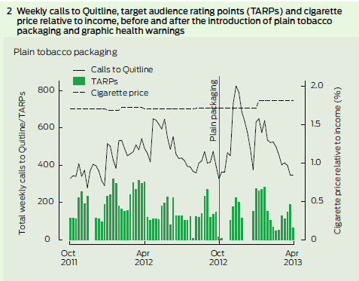
Intervention = Plain tobacco packaging and graphic health warnings
Outcome = Calls to Quitline
Young et al. MJA 2014;200(1):29.
See appendix: https://www.mja.com.au/journal/2014/200/1/association-between-tobacco-plain-packaging-and-quitline-calls-population-based

Slide 16


Main strengths and limitations of ITS
Strengths Takes into account pre-existing trends and patterns Selection bias and confounding are rare, assuming the underlying population is stable | Limitations Alternate explanations for the observed changes cannot definitively be ruled out, such as co-interventions at the same time It has limited ability to discern person-level predictors

Slide 17
Intervention impact – questions to consider
What is the shape of the impact?
Was the impact immediate or delayed (lagged)?
Could a change have occurred in anticipation of the intervention?
Were there any other changes/intervention during the time period?

Slide 18
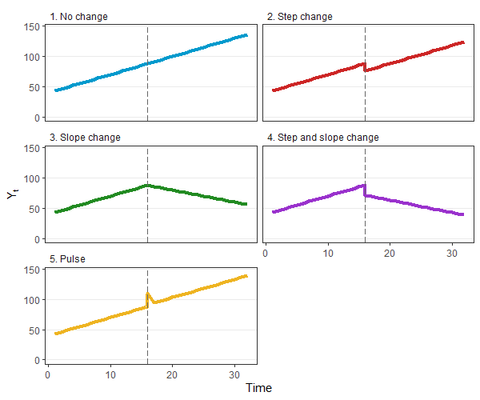
An immediate shift in the time series after the date of the intervention, either up or down, that is sustained for the duration of the study period.
Step change (aka level shift)

Slide 19
An immediate change in the slope (i.e. the rate of change in the outcome over time) after the date of the intervention. The slope may change sign (from positive to negative), or the rate of increase/decrease may get smaller or larger.
Slope change (aka ramp)

Slide 20
It is not uncommon to see a step change AND slope change combined. In this scenario, the time series immediately shift up or down, in addition to a change in the rate of change of the outcome.
Step change AND slope change

Slide 21
A temporary change in the outcome immediately after the date of the intervention, that reverts to pre-intervention levels. The duration of the pulse can vary from one time unit, to multiple.
Pulse change

Slide 22
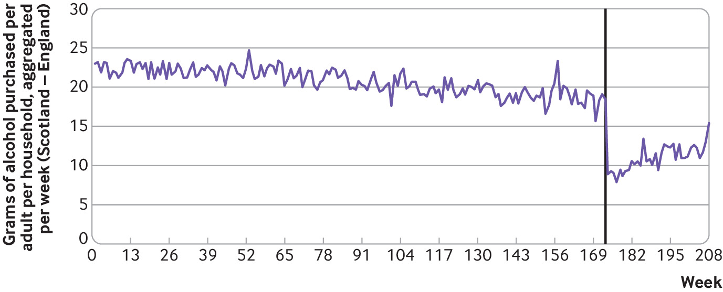
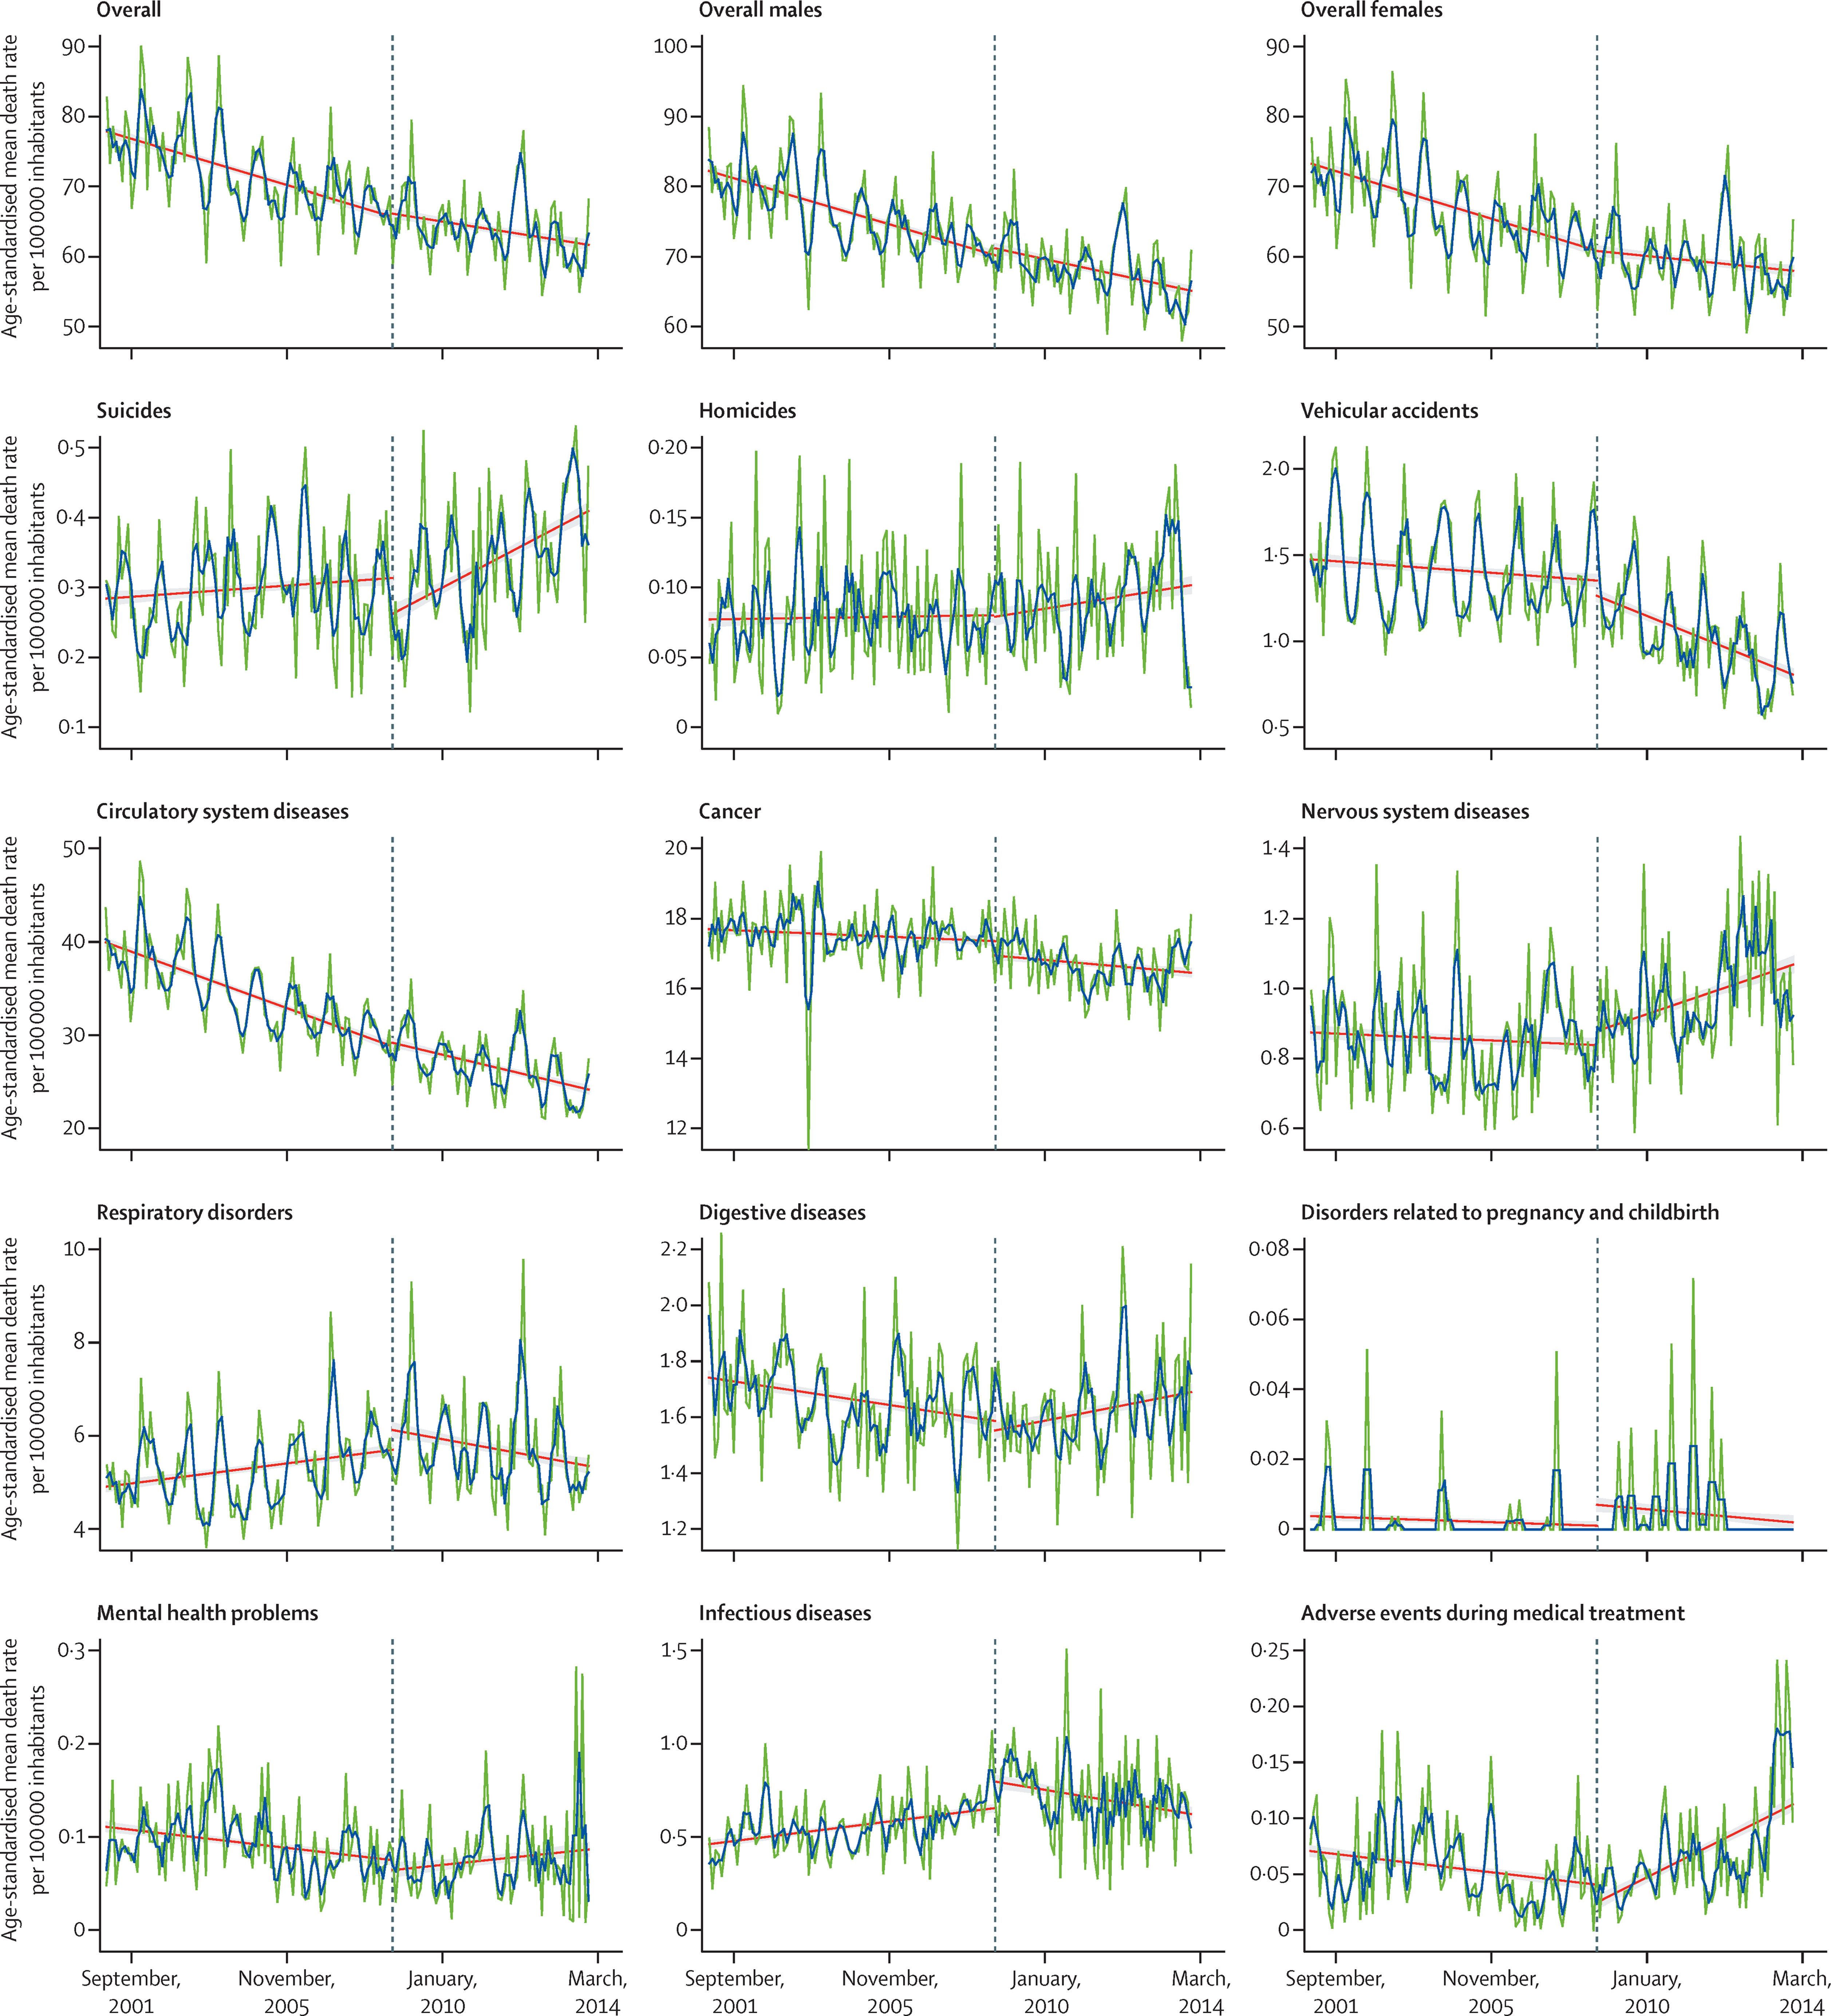
Real life examples
Schaffer et al. JAMA Network Open 2019;2(9):e1911590; O’Donnell et al. BMJ 2019;366:I5274; Laliotis et al. Lancet Public Health 2016;1(2);e56.

Slide 23
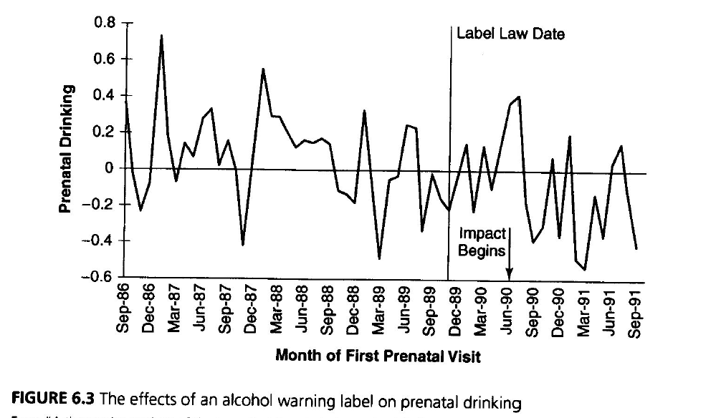
Delayed impact
For some interventions and outcomes, the impact of the intervention may be delayed by one or multiple time points.
Shadish, Cook, Campbell. Experimental and quasi-experimental designs for generalized causal inference. 2002

Slide 24
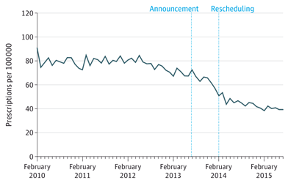
What types of interventions can be evaluated?
Occurs at well-defined point in time, with clear “before” and “after” periods
Affects a large proportion of population of interest
Be aware that changes may occur in anticipation of the intervention if people know it is coming—this isn’t a dealbreaker but must be accounted for or excluded in your model
Example: Rescheduling of alprazolam to a “Controlled Drug” in Feb 2014—but the TGA announced this change in July 2013
Source: Schaffer et al. JAMA Intern Med 2016.

Slide 25
What determines the shape of the impact?
The nature of the intervention
The nature of the outcome
The frequency of the time series
The same intervention can lead to different types of impacts for different outcomes.

Slide 26
Is the impact immediate/delayed/gradual? Temporary/permanent?
Intervention | Outcome | Immediate or delayed? | Shape of impact?
Increase in tax on tobacco products | Sales of cigarettes | ? | ?
 | Smoking rates | ? | ?
 | Lung cancer diagnoses | ? | ?
Removal of high-strength opioids from the market | High-strength opioid sales | ? | ?
 | Opioid dependence treatment | ? | ?

Slide 27
Negative control series
The main limitation of ITS analysis is potential confounding by other changes or interventions that may have occurred around the same time as the intervention of interest (history bias)
Adding a control series strengthens causal inference from ITS analysis.
A “negative control” is a group or outcome where you expect to see no impact (more common in ITS analysis).
A “positive control” is a group or outcome where you expect to see an impact (less common in ITS analysis).

Slide 28
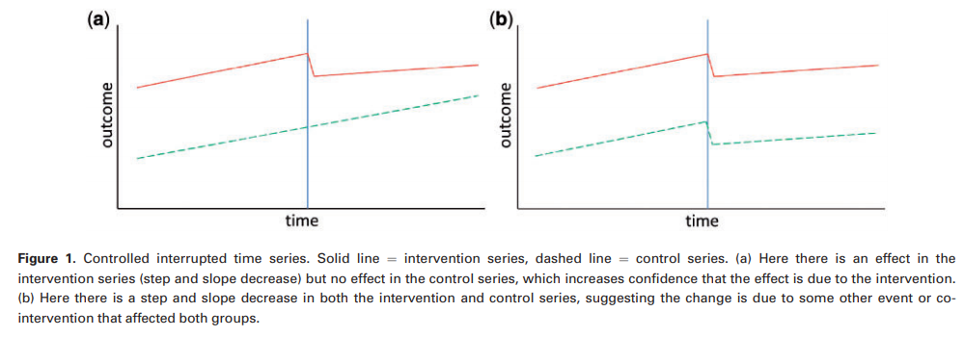
How to interpret negative control series?
Source: Lopez Bernal et al. Int J Epidemiol 2018;0(0):1-12.

Slide 29
Examples of negative control series
Same outcome in different (but similar) population not affected by intervention
Different (but similar) outcome not affected by intervention in same population
Same outcome in same population but in different time period
Exercise
Think of a negative control series for each of the three types above for the intervention of price increase on alcopops

Slide 30
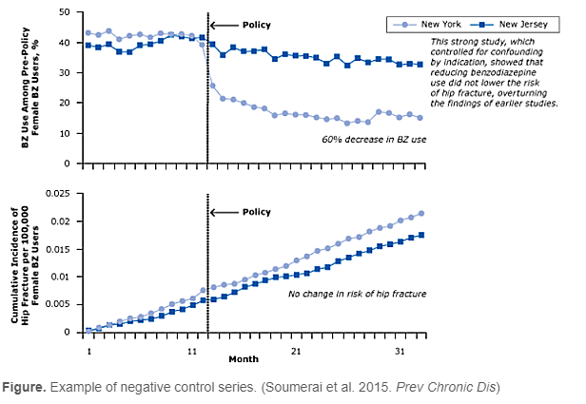
Negative control series – example
Notes:
Benzodiazepine (BZ) use and risk of hip fracture among women with Medicaid before and after regulatory surveillance restricting BZ use in New York State.

Slide 31
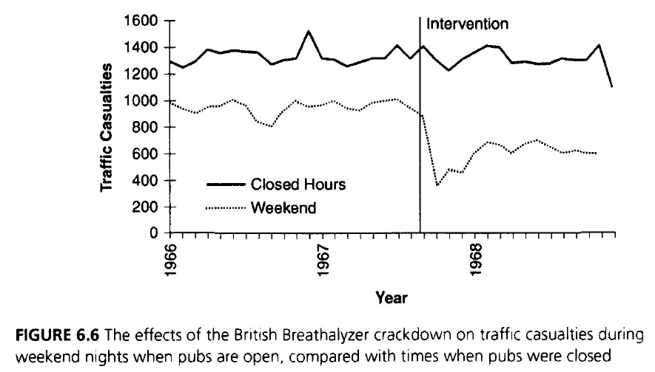
Negative control series – example
Shadish, Cook, Campbell. Experimental and quasi-experimental designs for generalized causal inference. 2002

Slide 32

ABC Catalyst program claims high cholesterol does not cause heart disease.
Two-part program claims high cholesterol does no cause heart disease…
…and statins (cholesterol-reducing drugs) do not save lives
Medical experts respond to say these claims are dangerous.
Watch this clip from Media Watch online here

Slide 33
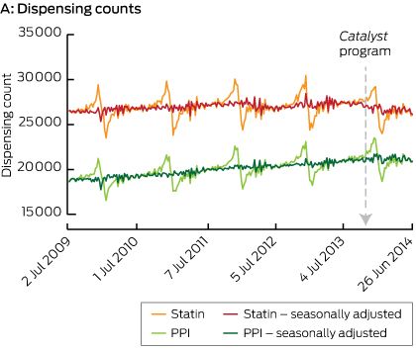
Negative control series – example
Schaffer et al. MJA 2015;202(11):591.
Notes:
Proton pump inhibitors (PPIs) are the most commonly prescribed class of medication for the treatment of heartburn and acid-related disorders.

Slide 34
Undertaking ITS analysis
We will discuss two modelling approaches
Segmented regression
ARIMA models
Notes:
Autoregressive Integrated Moving Average

Slide 35
Segmented regression modelling

Slide 36
Step 1: Visualise your data
The first step is always to visualise your series using one or more of a time series line graph, seasonal plots, and decomposition plots.
Some questions to ask when visualising your data:
What is the potential shape of the intervention?
Is the impact delayed?
Is there a trend in the data?
Will we need to adjust for seasonality?
Are there any potential extreme or outlier data points that warrant further investigation?

Slide 37
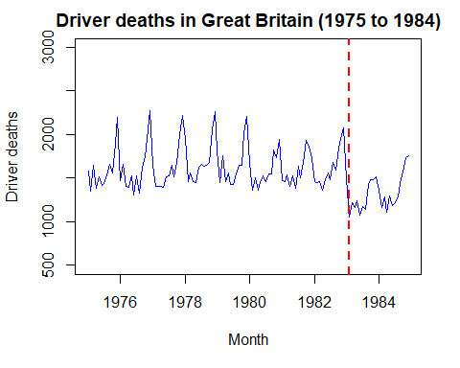
Introduction of seatbelt law in Great Britain in March 1983

Slide 38
Step 2: If data have non-constant variance, apply log transformation

Slide 39

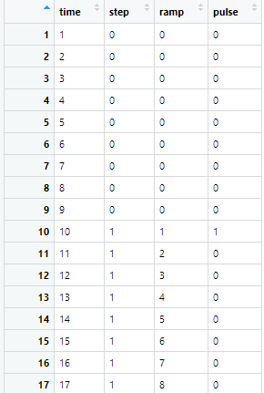
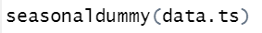

Step 3: Create necessary variables
Pre-intervention
For a segmented linear regression, you will typically need variables representing the following:
Time since start of study (time)
Intervention (step change)
Time since intervention (slope change or ramp)
If necessary:
Pulse change
Seasonal dummy variables
Post-intervention

Slide 40
Step 3: Create necessary variables
Consider also:
Could the intervention impact be delayed/lagged? If so by how much?
Could a change in the outcome have changed prior to the intervention date?
If so, adjust your variables as necessary.

Slide 41
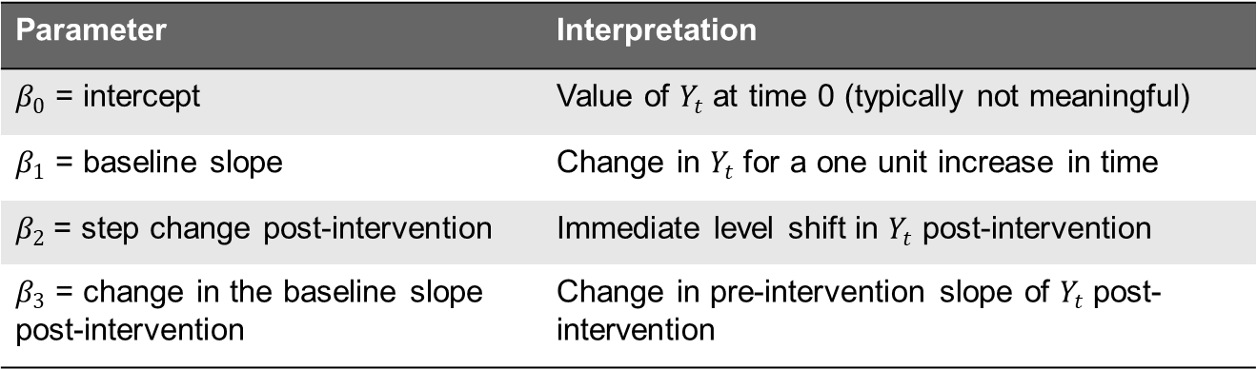
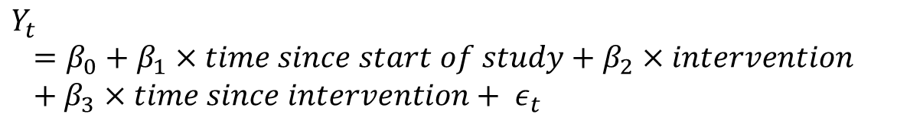
Step 4: Estimate model
$$Y_{t}=β_{0}+β_{1}×time since start of study+β_{2}×intervention+β_{3}×time since intervention+ ε_{t}$$
Parameter | Interpretation
$β_{0}$ = intercept | Value of $Y_{t}$ at time 0 (typically not meaningful)
$β_{1}$ = baseline slope | Change in $Y_{t}$ for a one unit increase in time
$β_{2}$= step change post-intervention | Immediate level shift in $Y_{t}$ post-intervention
$β_{3}$ = change in the baseline slope post-intervention | Change in pre-intervention slope of $Y_{t}$ post-intervention

Slide 42
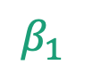
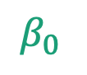
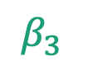
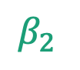
Step 4: Estimate model – visualising parameters
Intervention
Outcome Y(t)
$β_{2}$
$β_{3}$
$β_{1}$
$β_{0}$
Time t

Slide 43
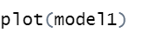
Step 4: Estimating model in R
Run model, including variables representing impact of intervention and to control for trend/seasonality
Check for residual autocorrelation
Plot residuals to check model fit

Slide 44
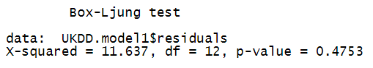
Step 5: Check residuals of model
Use Ljung-Box test to check for residual autocorrelation – a p-value <0.05 indicates significant autocorrelation.
If your model isn’t a good fit....
Try transforming your outcome (if you haven’t already)
You may not have adequately controlled for seasonality
You may have extreme values that have a large influence on results
If there is significant residual autocorrelation – you may have to consider an AR or ARIMA model

Slide 45
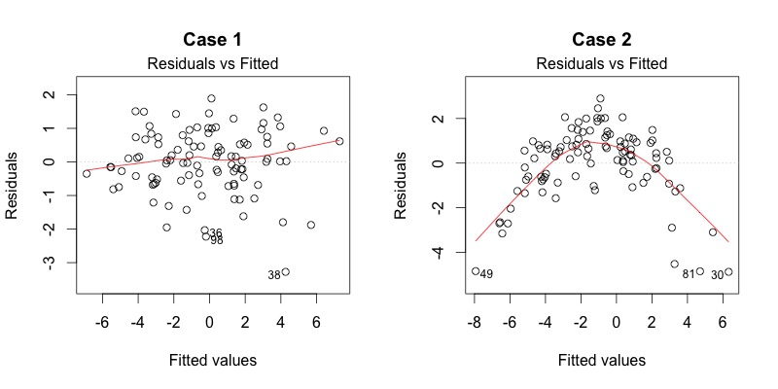
Step 5: Check residuals of model
https://data.library.virginia.edu/diagnostic-plots/

Slide 46
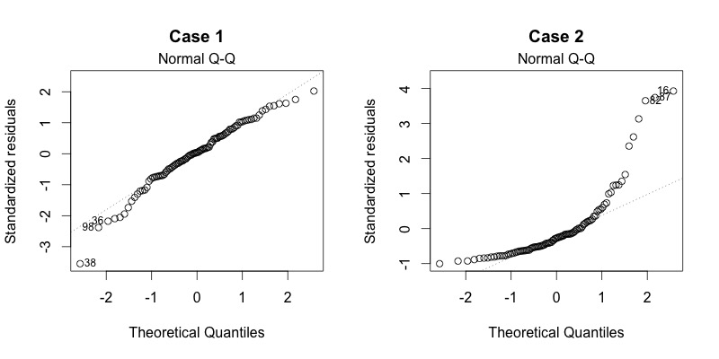
Step 5: Check residuals of model
https://data.library.virginia.edu/diagnostic-plots/

Slide 47
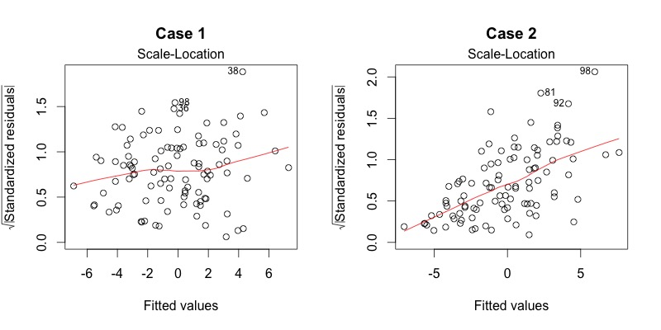
Step 5: Check residuals of model
https://data.library.virginia.edu/diagnostic-plots/

Slide 48
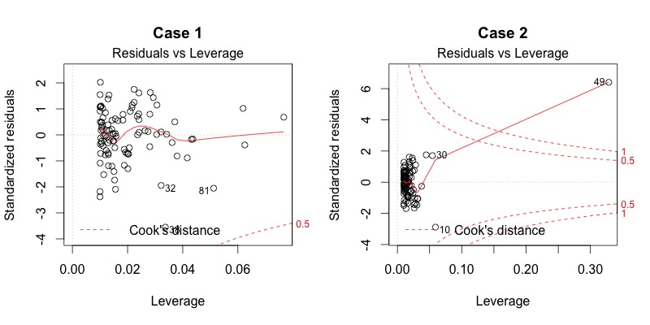
Step 5: Check residuals of model
https://data.library.virginia.edu/diagnostic-plots/

Slide 49
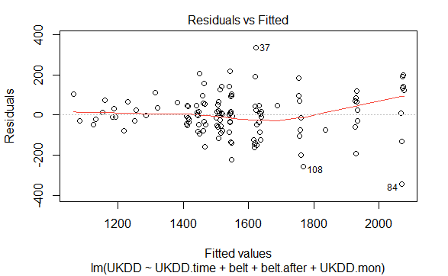
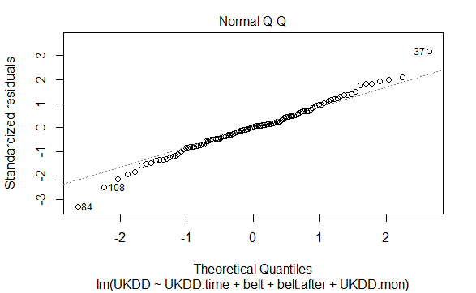
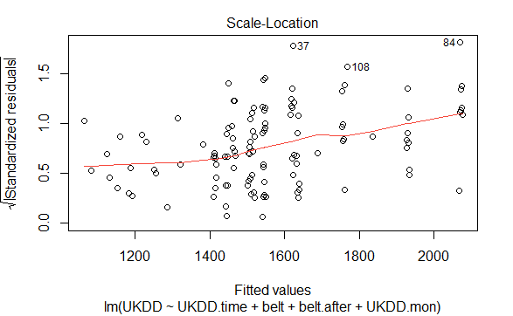
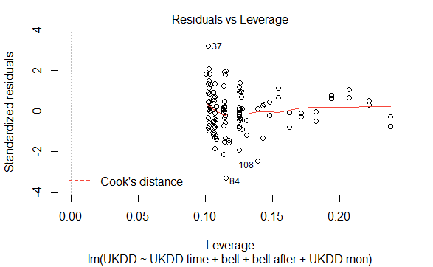
Step 5: Checks residuals of model

Slide 50
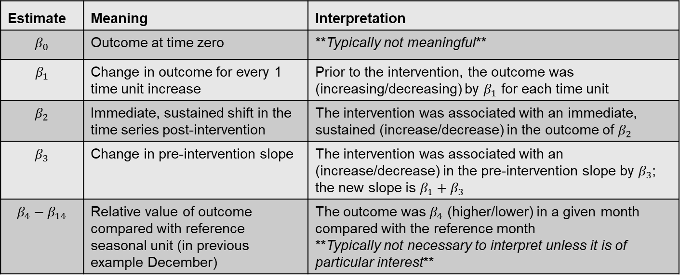
Step 6: Interpret results and write conclusion
$$Y_{t}=β_{0}+β_{1}×time+β_{2}×intervention+β_{3}×time since intervention+ β_{4}{Jan}_{t}+β_{5}{Feb}_{t}+β_{6}{Mar}_{t}+β_{7}{Apr}_{t}+β_{8}{May}_{t}+β_{9}{Jun}_{t}+β_{10}{Jul}_{t}+β_{11}{Aug}_{t}+β_{12}{Sep}_{t}+{β_{13}{Oct}_{t}+β_{14}{Nov}_{t}+ε}_{t}$$
Estimate | Meaning | Interpretation
$$β_{0}$$ | Outcome at time zero | **Typically not meaningful**
$$β_{1}$$ | Change in outcome for every 1 time unit increase | Prior to the intervention, the outcome was (increasing/decreasing) by $β_{1}$ for each time unit
$$β_{2}$$ | Immediate, sustained shift in the time series post-intervention | The intervention was associated with an immediate, sustained (increase/decrease) in the outcome of $β_{2}$
$$β_{3}$$ | Change in pre-intervention slope | The intervention was associated with an (increase/decrease) in the pre-intervention slope by $β_{3}$; the new slope is $β_{1}+β_{3}$
$$β_{4}−β_{14}$$ | Relative value of outcome compared with reference seasonal unit (in previous example December) | The outcome was $β_{4}$ (higher/lower) in a given month compared with the reference month **Typically not necessary to interpret unless it is of particular interest**

Slide 51
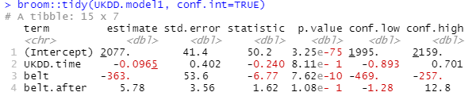
Step 6: Interpret results and write conclusion
In the 10 years prior to the introduction of the seatbelt law in March 1983, the number of driver deaths per month was constant with a baseline slope of -0.1 (95% CI -0.9 to 0.7). After introduction of the law, there was an immediate decrease in driver deaths of 363 (95% CI -469 to -257) that was sustained until the end of 1984. There was no change in the monthly slope (6, 95% CI -1 to 13).

Slide 52
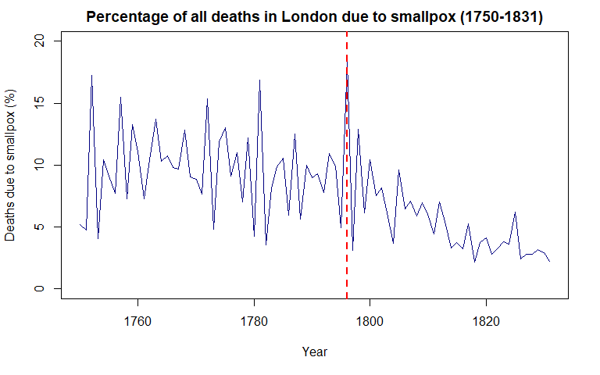
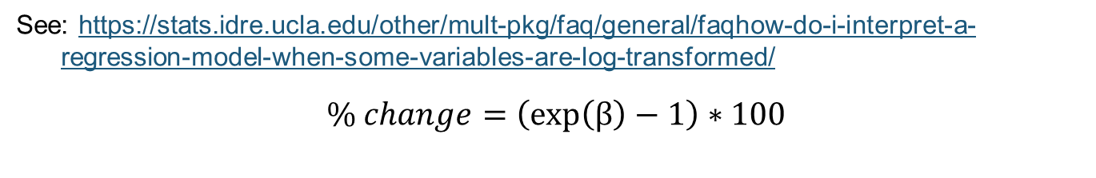
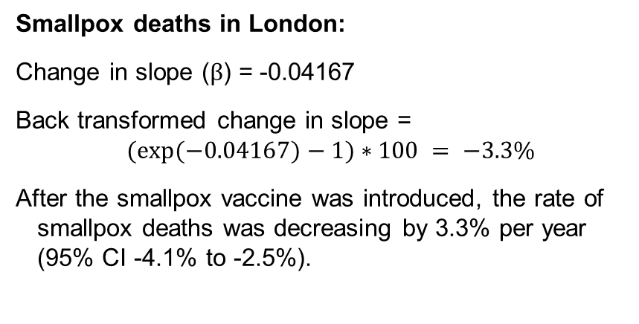
What if your outcome is log transformed??
See: https://stats.idre.ucla.edu/other/mult-pkg/faq/general/faqhow-do-i-interpret-a-regression-model-when-some-variables-are-log-transformed/
$\% change=\left(exp\left(β\right)−1\right)∗100$
Smallpox deaths in London:
Change in slope ($β$) = -0.04167
Back transformed change in slope =
$(exp⁡(−0.04167)−1)∗100 = −3.3\%$
After the smallpox vaccine was introduced, the rate of smallpox deaths was decreasing by 3.3% per year (95% CI -4.1% to -2.5%).

Slide 53
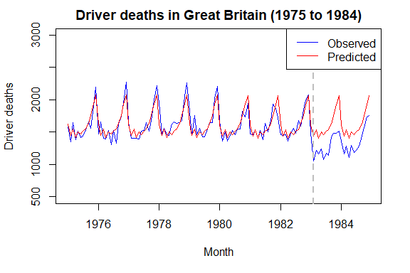
Step 7: Visualise your results (plot counterfactual)
Do your estimates make sense???
See also: Turner et al. Creating effective interrupted time series graphs: Review and recommendations. Research Synthesis Methods https://doi.org/10.1002/jrsm.1435

Slide 54
AR and ARIMA modelling

Slide 55


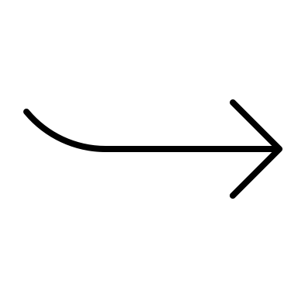
What is an ARIMA model?
ARIMA
Autoregressive
Moving average
Integration (differencing)

Slide 56
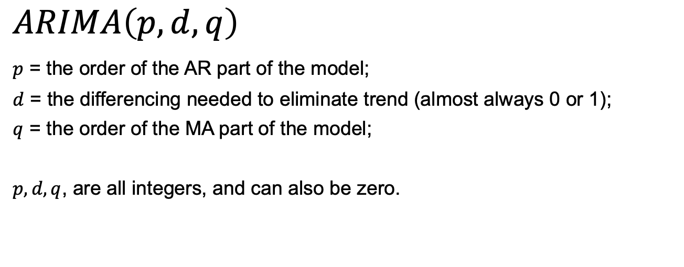
ARIMA notation
$$ARIMA\left(p,d,q\right)$$
$p$ = the order of the AR part of the model;
$d$ = the differencing needed to eliminate trend (almost always 0 or 1);
$q$ = the order of the MA part of the model;
$p, d, q$, are all integers, and can also be zero.
p is the order of the autoregressive component
$$Y_{t}=c+φ_{1}Y_{t−1}+φ_{2}Y_{t−2}+…+φ_{p}Y_{t−p}+ε_{t}$$
q is the order of the moving average component
$$Y_{t}=c+ε_{t}+θ_{1}ε_{t−1}+θ_{2}ε_{t−2}+…+θ_{q}ε_{t−q}$$

Slide 57
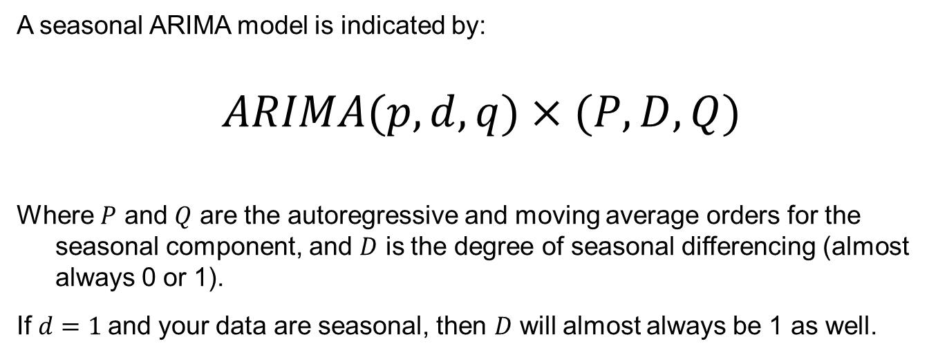
ARIMA notation
A seasonal ARIMA model is indicated by:
$$ARIMA(p,d,q)×(P,D,Q)$$
Where $P$ and $Q$ are the autoregressive and moving average orders for the seasonal component, and $D$ is the degree of seasonal differencing (almost always 0 or 1).
If $d=1$and your data are seasonal, then $D$ will almost always be 1 as well.

Slide 58


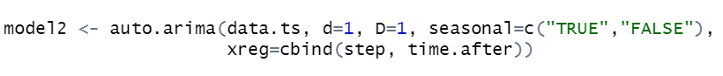

ITS analysis with ARIMA modelling
Trend is dealt with by differencing (not by inclusion of a time covariate)
Seasonality is dealt with by differencing (not by seasonal dummy variables)
Include external regressors to estimate change in level (step change) and change in slope
*Note: with a full ARIMA model, you cannot easily estimate the pre-intervention trend

Slide 59
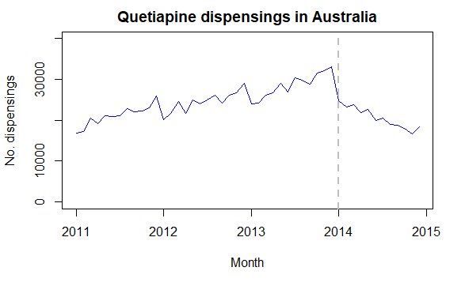
Example: quetiapine dispensing after increased restrictions on its prescribing
What is the potential shape of the intervention?
Do you expect there to be seasonality?
Is there a trend?

Slide 60
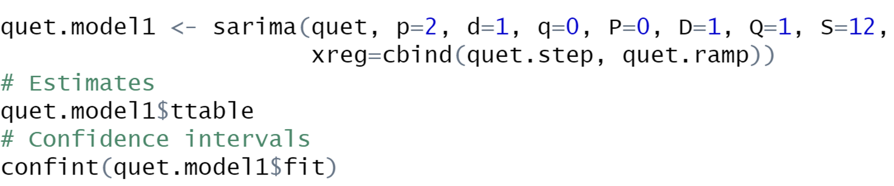
Explore model order with auto.arima | Fit model with sarima
Due to seasonality and since d=1, D=1
Due to trend, d=1

Slide 61


Interpreting results – ARIMA
quet.step = before or after intervention
quet.ramp = time since intervention

Slide 62

Plot counterfactual

Slide 63
Segmented regression or ARIMA??
 | Segmented regression (SR) | ARIMA (including AR models)
Data distribution | Normal (continuous outcome) Poisson (count outcome) | Normal (continuous outcome)
Trends | Simple, regular trends only (e.g. linear) | Complex trends
Seasonality | Simple seasonality via dummy variables | Complex seasonality
Autocorrelation | For simple autocorrelation, accounting for trends and seasonality may remove it | Complex autocorrelation
Implementation | Simple | Can be challenging to find the most appropriate p, q, P, and Q terms
Baseline slope | Can be estimated | AR model – can be estimated ARIMA model – cannot be estimated
R functions | lm()or glm() | auto.arima()in forecast package sarima()in astsa package

Slide 64
Final words
Interrupted time series analysis is a powerful approach to evaluate the impact of large-scale interventions, especially when combined with control series
To ensure robust results, any modelling approach should take into account trends, seasonality, and autocorrelation
Simpler is (usually) better—sometimes a simple linear regression is all you need!
As with most observational studies, be wary of inferring causal relationships

